Slide 1
Extragalactic Astrophysics and Cosmology Group Study 2013
Predictions Group

Slide 2
Our Aim:
To be able to predict the number of high redshift galaxies one would detect within a given absolute magnitude range for a given filter band.

Slide 3


How we intend to do this:
Find a general Schechter Function.
Mathematical process to convert Schechter Function into observing units.
Build program to automate process. IN PROCESS
Find plausible starting parameters.
Collate parameter data from papers. IN PROCESS
Determine parameter evolution with time. IN PROCESS
Plot results/ data visualisation.
Give to observers.
Refine technique- include more sophisticated adaptations.

Slide 4

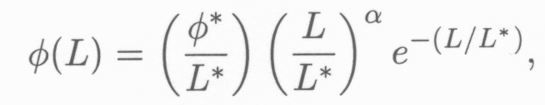

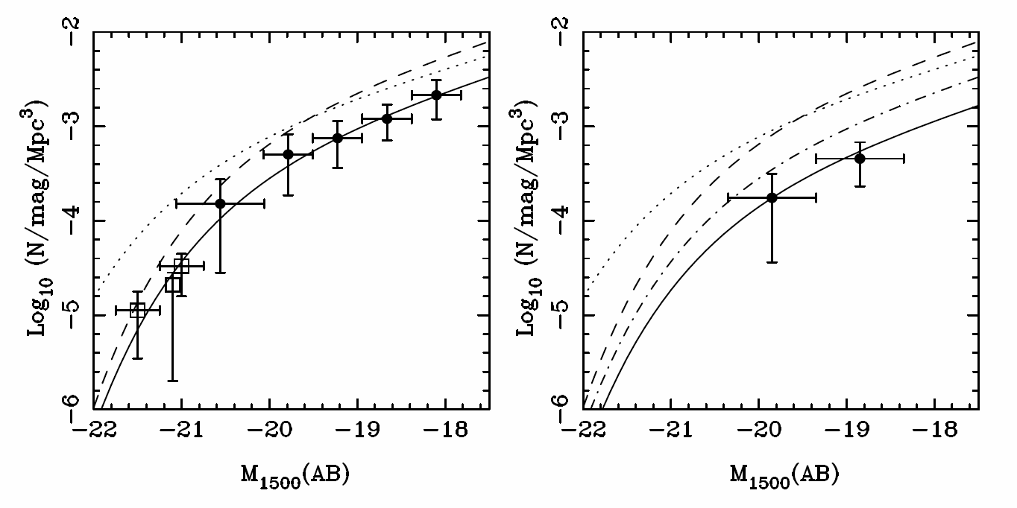
Schechter Function
Z=7
Z=8
(McLure, 2010)

Slide 5

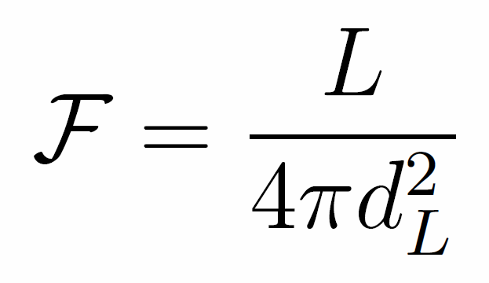
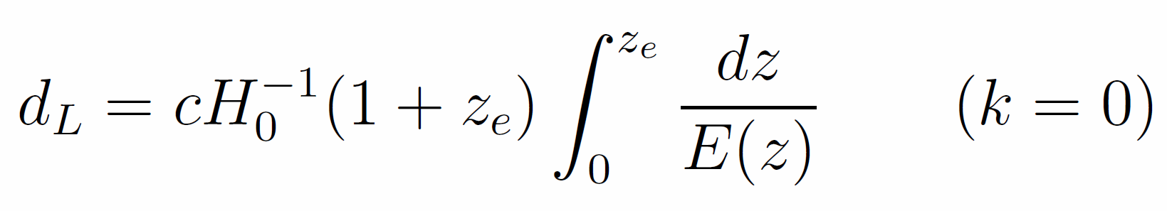
Co-moving Distance
Luminosity Distance
Magnitude Conversion
Notes:
dH (hubble distance) radius of the visible universe. Luminosity distance is redshifted. Magnitude conversion is for AB system.

Slide 6
Assumptions
Universe is:
Flat
Matter Dominated
No cosmic variance
Constant Schechter Function
Parameters of the Schechter function do not change as a function of redshift.

Slide 7
Schechter Function
Next step is to add variation in the parameters of the Schechter Equation as a function of redshift.
Involve using real data from observations
Extrapolate backwards for higher redshift
Try different fits for data.

Slide 8
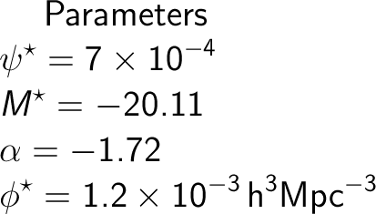
Parameters
Parameters taken from papers on high redshift galaxies.

Slide 9
Programs A. And B.
We have two programs computing the same quantities in slightly different ways in order to validate any results we obtain.
These have been mainly written by Owen and Andy.

Slide 10
Schechter Function Computation
Main aims: To give the observing group appropriate inputs, and to compare results with other code.
Results: Appropriately shaped Schechter function graph upon output, and a number of galaxies outputted, within apparent magnitude range.

Slide 11
Future Aims
Attempt to match outputted number with observed data at a variety of redshifts and apparent magnitudes
Get program to output effectively
Calculate Ionizing photon rate density from Schechter Function.
Integrate graphing function with code.
Parameters evolving with redshift.

Slide 12
Schechter function output

Slide 13
Plans for improvement
Converging time analysis to optimise accuracy for a given computation time.
Implement upper and lower bounds on parameter evolution
Output distributions
Create intuitive input system

Slide 14
How we could refine this
Can refine code by accounting for cosmic variance and including
gravitational lensing, where applicable.
Cosmic Variance
The Universe is only homegeneous at the largest scale (>1Gpc).
Measurements are affected by the large-scale cosmic structure.
In general, the dominant source of error, well in excess of Poisson noise, comes from Cosmic Variance.
Gravitational Lensing (as per Catherine’s slides)
Galaxies at extreme redshifts are too faint to detect.
Their apparent magnitude can be amplified by a factor of ten by using nearby superclusters as Gravitational lenses.
This allows us to probe further back towards the beginning of reionization.

Slide 15
Allowing for Cosmic Variance
Any number or density measurement derived from a galaxy population is susceptible to Cosmic Variance.
Therefore, any estimates produced for the observing team from the code, should account for this in some way.
The Cosmic Variance of a survey is empirically reduced with multiple sightlines, by √N – where N is the no. of sightlines.
It is also lower for higher aspect ratio surveys.
The bulk of the refining process will be using this information to best advise the observing team on how to proceed with their survey, to obtain a fair sampling of galaxies i.e. one that is likely to representative of the galaxy distribution as a whole, at that cosmic time.

Slide 16
Plans for the future:
Get both programs working.
Continue trying to gather relationship of parameters with time.
Research into cosmic variance; how are we going to include it in our calculations? What formulae might we need?
Produce refined programs.
Meanwhile all continually working on our own individual contributions to the report which were designated last Tuesday.

